Slide 1


Network protocols & security
24EC2210
Topic:
STCP Protocol
Session - 27

Slide 2
SCTP Protocol
SCTP stands for Stream Control Transmission Protocol.
Designed for Internet applications.
SCTP combines the best features of UDP and TCP.
SCTP is a reliable message-oriented protocol.
It preserves the message boundaries, and at the same time, detects lost data, duplicate data, and out-of-order data.
It also has congestion control and flows control mechanisms.

Slide 3
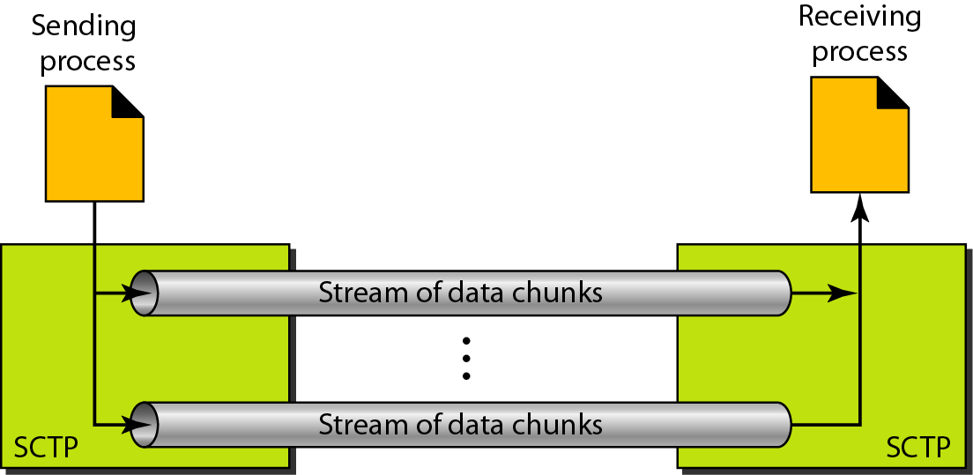
Figure 23.27 Multiple-stream concept

Slide 4

Note
An association in SCTP can involve multiple streams.

Slide 5
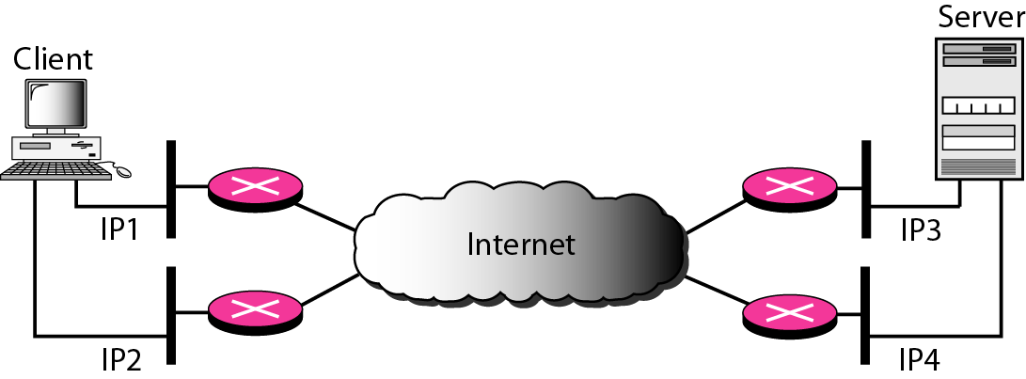
Figure 23.28 Multihoming concept

Slide 6
Features of SCTP
There are various features of SCTP, which are as follows −
Transmission Sequence Number
Stream Identifier
Stream Sequence Number
Packets
Flow Control
Error Control
Congestion Control

Slide 7
Note
SCTP association allows multiple IP addresses for each end.

Slide 8
Note
In SCTP, a data chunk is numbered using a TSN.

Slide 9
Note
To distinguish between different streams, SCTP uses an SI.

Slide 10
Note
To distinguish between different data chunks belonging to the same stream, SCTP uses SSNs.

Slide 11
Note
TCP has segments; SCTP has packets.

Slide 12
Features of SCTP…
Transmission Sequence Number
The unit of data in TCP is a byte. Data transfer in TCP is controlled by numbering bytes by using a sequence number.
On the other hand, the unit of data in SCTP is a DATA chunk that may or may not have a one-to-one relationship with the message coming from the process because of fragmentation.
Each data chunk is given a transmission sequence number.
Stream Identifier
In TCP, there is only one stream in each connection.
In SCTP, there may be several streams in each association.
Each stream in SCTP needs to be identified by using a stream identifier (SI).
Each data chunk must carry the SI in its header so that when it arrives at the destination, it can be properly placed in its stream.

Slide 13
Features of SCTP…
Stream Sequence Number
When a data chunk arrives at the destination SCTP, it is delivered to the appropriate stream and in the proper order.
This means that, in addition to an SI, each data chunk in each stream carries a stream sequence number (SSN).
Packets
In TCP, a segment carries data and control information.
Data is carried as a collection of bytes; control information is defined by six control flags in the header.
The design of SCTP is totally different.
In SCTP, data is carried as data chunks; control information is carried as control chunks.

Slide 14
Features of SCTP…
Flow Control
Like TCP, SCTP implements flow control to avoid overwhelming the receiver.
Error Control
Like TCP, SCTP implements error control to provide reliability.
TSN numbers and acknowledgement numbers are used for error control.
Congestion Control
Like TCP, SCTP implements congestion control to determine how many data chunks can be injected into the network.

Slide 15
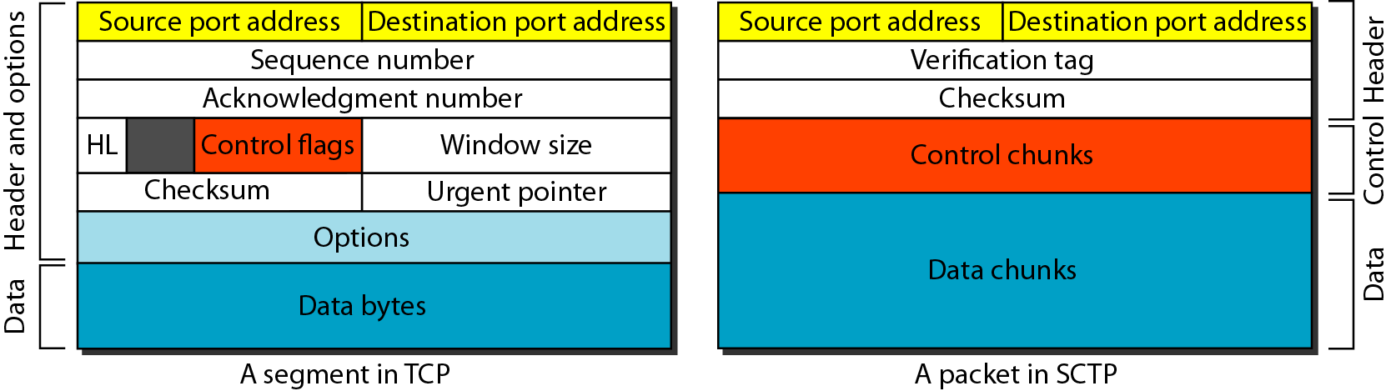
Figure 23.29 Comparison between a TCP segment and an SCTP packet

Slide 16
Note
In SCTP, control information and data information are carried in separate chunks.

Slide 17
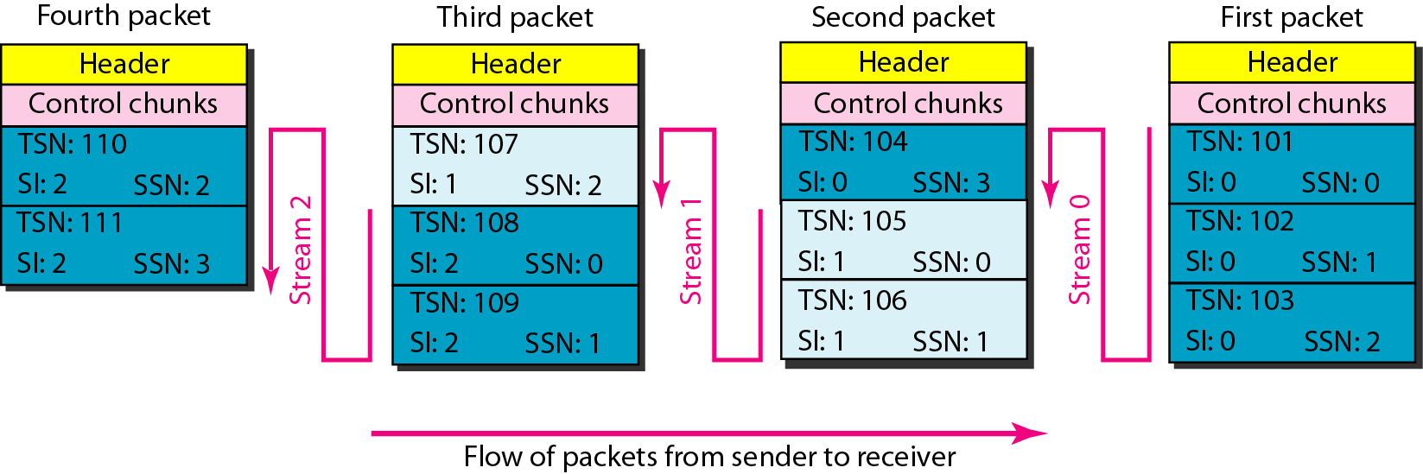
Figure 23.30 Packet, data chunks, and streams

Slide 18
Note
Data chunks are identified by three items: TSN, SI, and SSN.
TSN is a cumulative number identifying the association; SI defines the stream; SSN defines the chunk in a stream.

Slide 19
Note
In SCTP, acknowledgment numbers are used to acknowledge only data chunks;
control chunks are acknowledged by other control chunks if necessary.

Slide 20
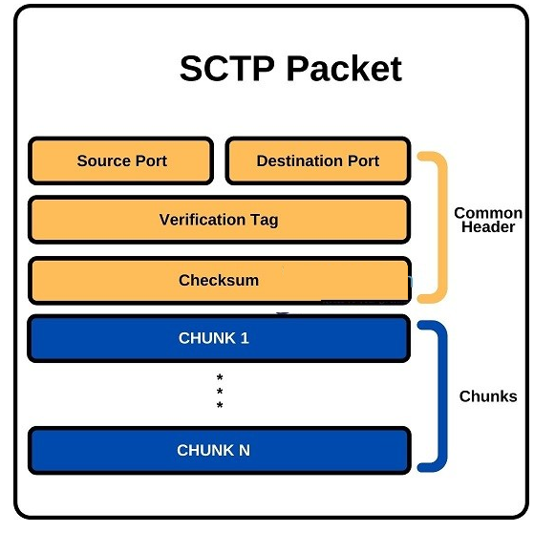
SCTP Packet
SCTP protocol packet consist of two main parts Header and Payload.
The Header is common, but Payload have variable chunks.
The Common SCTP header is 12 byte long and made of the 4 parts.
Port Number (Source): shows the sending port
Port Number (Destination): shows the receiving port
Verification tag: a 32-bit random value which differentiate the packets from the previous connection
Checksum: a CRC32 algorithm for detection of error.

Slide 21
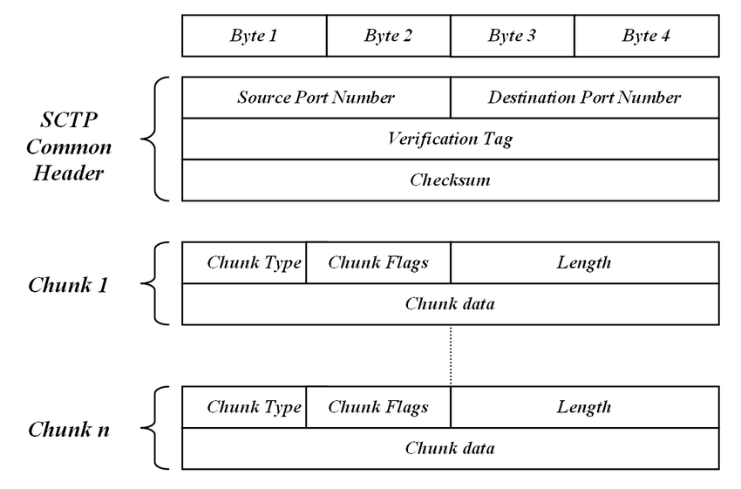
SCTP Packet…

Slide 22
Note
A connection in SCTP is called an association.

Slide 23
Note
No other chunk is allowed in a packet carrying an INIT or INIT ACK chunk.
A COOKIE ECHO or a COOKIE ACK chunk can carry data chunks.

Slide 24
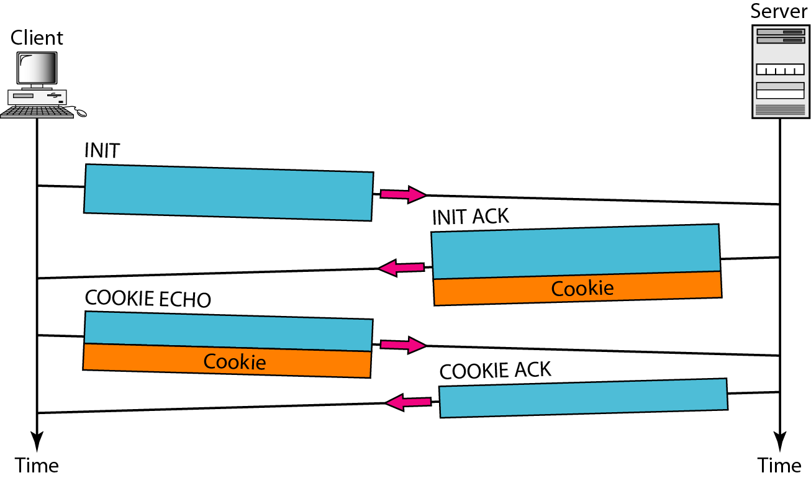
Figure 23.33 Four-way handshaking

Slide 25
Note
In SCTP, only DATA chunks consume TSNs;
DATA chunks are the only chunks that are acknowledged.

Slide 26
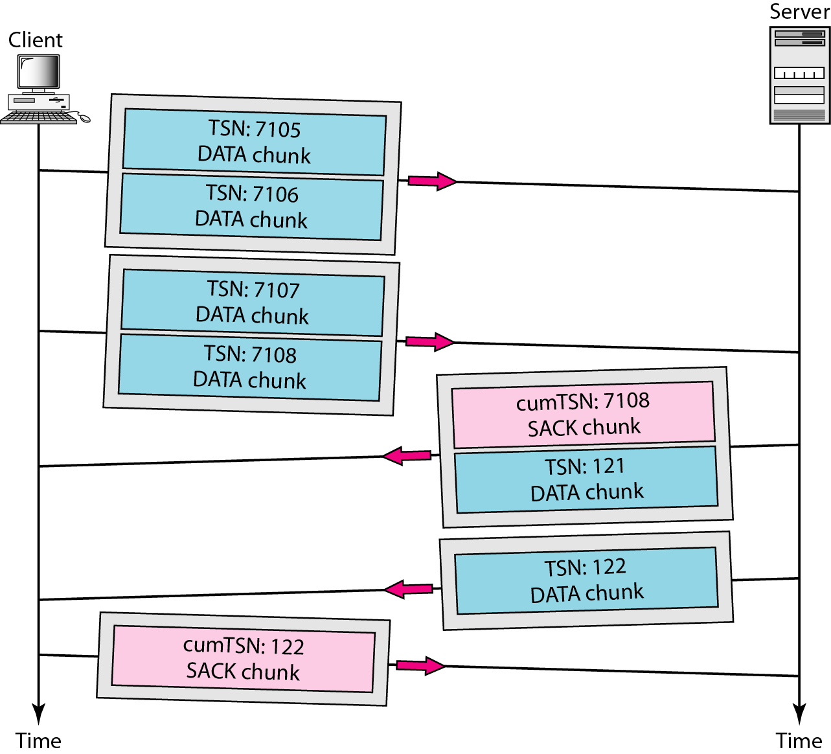
Figure 23.34 Simple data transfer

Slide 27
Note
The acknowledgment in SCTP defines the cumulative TSN, the TSN of the last data chunk received in order.

Slide 28
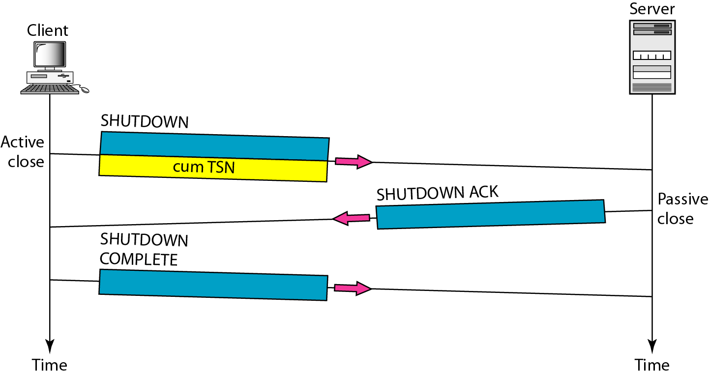
Figure 23.35 Association termination

Slide 29
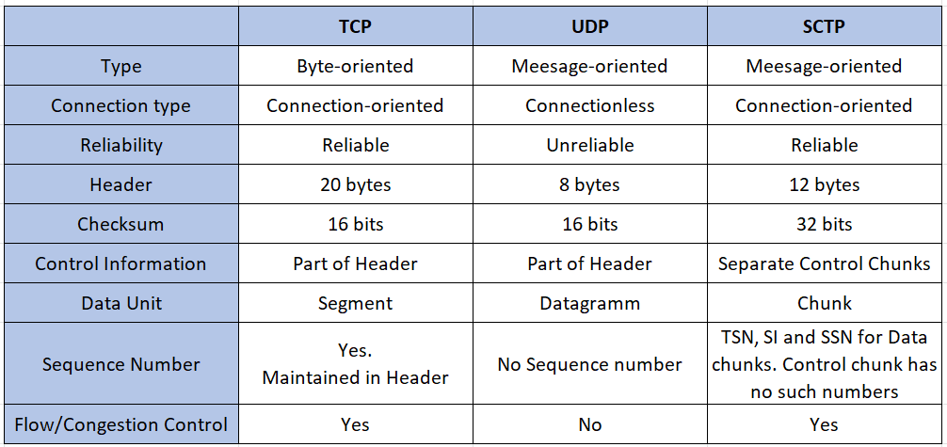
Comparison of TCP, UDP and SCTP

Slide 30
THANK YOU
Team –Network Protocols and Security

